Slide 1

Development of curriculum leaders
Possible approaches to support current and aspiring curriculum leaders
Sheena Warman & Elizabeth Armitage-Chan (co-PIs), working with Melinda Bell; Martin Cake; Kate Cobb; Heidi Janicke; Sarah Kelly; Emma Read.
© 2026. Produced through a collaborative project involving colleagues at the University of Bristol, St George's University, Royal Veterinary College, Murdoch University, University of Nottingham, and The Ohio State University. Licensed under Creative Commons Attribution-NonCommercial 4.0 International (CC BY-NC 4.0). Artwork developed by colleagues at St George's University.

Slide 2












Acknowledgements
Funding: This work is the product of an AAVMC CIVME (American Association of Medical Colleges’ Council on International Veterinary Medical Education) research grant.
Grant title: “What makes a curriculum leader in veterinary education?”
Contributors: Sheena Warman & Elizabeth Armitage-Chan (co-PIs), working with Melinda Bell; Martin Cake; Kate Cobb; Heidi Janicke; Sarah Kelly; Emma Read.
Warman and Kelly
Cobb
Bell and Cake
Janicke
Armitage-Chan
Read
Thanks to Sarah Gluschitz at St. George’s University for the Illustrations

Slide 3


Understand Individual motivations for curriculum leadership
1

Slide 4
Faculty
Understand Individual Motivations for Curriculum Leadership
Deans
1
Acknowledge personal motivations: seek challenges in pedagogy and leadership
Expect varied rewards: salary, conference, courses, coaching
Recognise diverse motivations: extrinsic (titles, money) and intrinsic (service, change, growth)
Reward with fair pay, promotions, autonomy and development opportunities.

Slide 5

Focus on leadership training to navigate challenges
2

Slide 6
Faculty
Focus on Leadership Training to Navigate Challenges
Deans
2
Prioritize leadership skill development through training & reflection.
Step into challenging roles to grow & learn.
Expect challenges; develop skills & support networks to navigate them.
Invest in team leadership & change training at all career levels.
Identify and nurture future leaders with opportunities & training.
Acknowledge challenges of curriculum leadership
Provide time, resources, and support for skill development.

Slide 7

Provide opportunities for educational theory learning
3

Slide 8
Faculty
Provide Opportunities for Educational Theory Learning
Deans
3
Pursue formal & informal training in educational theory.
Learn from experienced peers & embrace educational literature.
Consider post-graduate & professional qualifications.
Allocate time & funds for faculty development & post-graduate training.
Reward engagement in pedagogical training, formal & informal.
Recognize educational theory as a specialized field.

Slide 9

Highlight the importance of role models, mentoring, and networking
4

Slide 10
Faculty
Highlight the Importance of Role Models, Mentoring, and Networking
Deans
4
Find role models & mentors both internally and externally.
Expect and navigate challenges; seek trusted support.
Nurture professional networks; connect with peers in similar roles.
Acknowledge curriculum leadership challenges & tensions.
Build a supportive core team with diverse veterinary and educational expertise. ​
Fund networking across institutions.
Encourage mentorship and coaching opportunities.

Slide 11
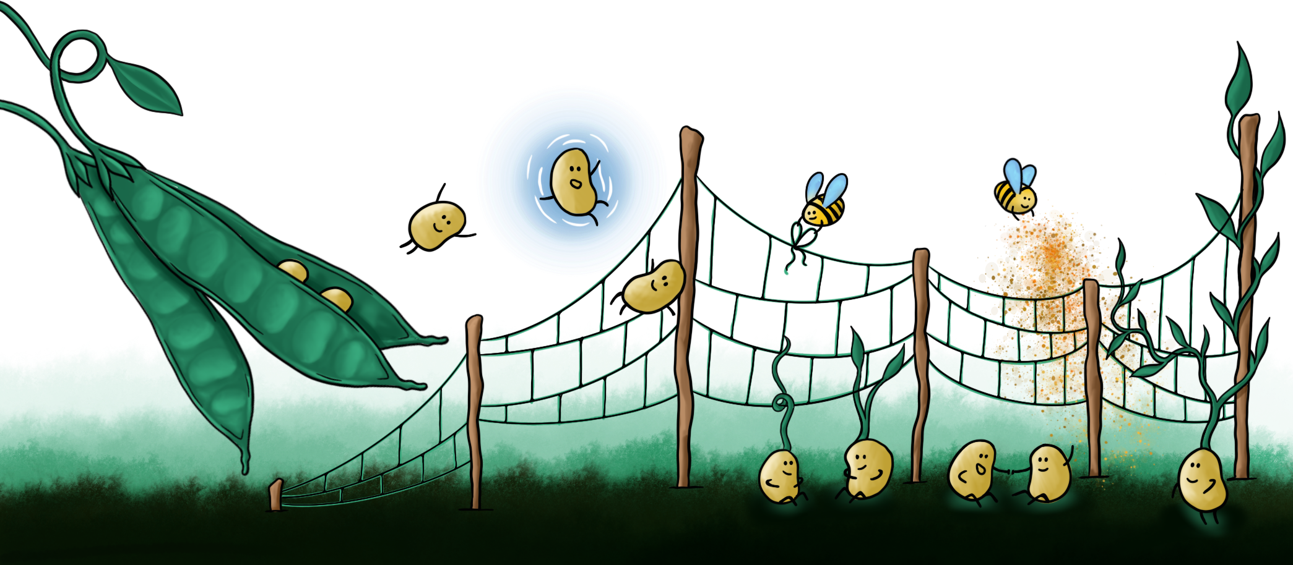
Value and support educational development at an institutional level
5

Slide 12
Faculty
Value and Support Educational Development at an Institutional Level
Deans
5
Highlight resource needs for sustainable curriculum development.
Develop strategies for educational research.
Seek personal development, networking, & leadership opportunities.
Establish a promotions framework rewarding educational leadership.
Provide time, resources, & staff for curricular goals.
Promote a culture valuing pedagogy alongside research & clinical service.
Prioritize networking & sharing with other institutions.
Value & celebrate educational research and outputs.

Slide 13
© 2026. Produced through a collaborative project involving colleagues at the University of Bristol, St George's University, Royal Veterinary College, Murdoch University, University of Nottingham, and The Ohio State University. Licensed under Creative Commons Attribution-NonCommercial 4.0 International (CC BY-NC 4.0). Artwork developed by colleagues at St George's University.
Based on the following publications:
Armitage-Chan E, Bell M, Cake M, Cobb KA, Janicke HJ, Kelly S, Read E, Warman S (2023) “Going from strength to strength”. Delving into professional identity formation of veterinary curriculum leaders: a narrative study. Journal of Veterinary Medical Education, e20230152 https://doi.org/10.3138/jvme-2023-0152
Warman SM, Armitage-Chan E, Banse H, Khosa D, Noyes JA, Read EK (2023) Preparing veterinarians to practice across the spectrum of care: an integrated educational approach. Advances in Small Animal Care 4 171-183 https://utppublishing.com/doi/epub/10.3138/jvme-2022-0098

